Slide 1
Darshan University

Slide 2
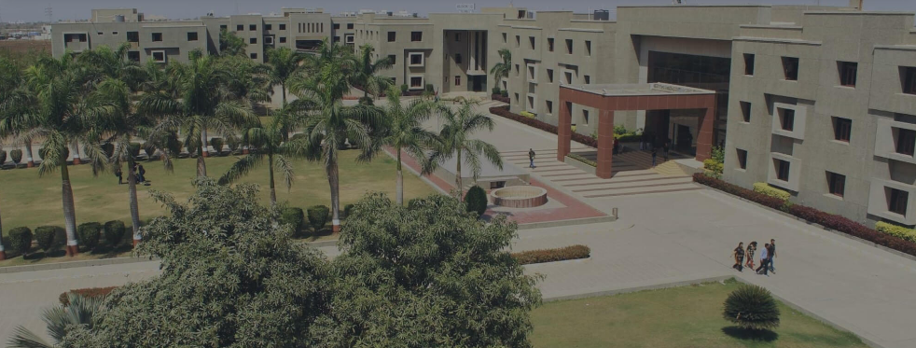
About University

Slide 3
Darshan University (DU) is a prominent institution offering a broad slate of academic programs and professional courses at the undergraduate, graduate, and postgraduate levels in Engineering & Technology, Science, Management, and Yoga. The University is located in peaceful and sylvan surroundings with a distinctive collegiate structure, about 19 km from Rajkot, Gujarat, India. It was established as an Engineering Institute in 2009 by Shree G. N. Patel Education & Charitable Trust with the objective of imparting quality education and training in various fields of Engineering and Technology. It has since been transformed into Darshan University through an Act by the Government of Gujarat under the Gujarat State Private Universities (Amendment) Act, 2021 (Act No. 15).
Since its inception, the institution has grown steadily and created a unique identity in the field of Engineering & Technology by implementing a skill- and training-based foundation for education. The academic environment on campus fosters creativity and encourages the exploration of technical skills. Darshan University is committed to the generation of knowledge, fostering innovation, and contributing to the development of the Nation.

Slide 4

Our Motto
This verse advises us to perform our allocated duty excellently. Kaushalam signifies doing work with devotion and without attachment. Such detached attitude enhances its values and improves the concentration and skill of the worker. If we work with elegance, fortitude, and skill our Body-Mind-Soul will co-operate with our hands. Any work becomes valuable if carried out with full concentration, dedication, and abilities and also helps us to become valuable to others as well as to society.

Slide 5
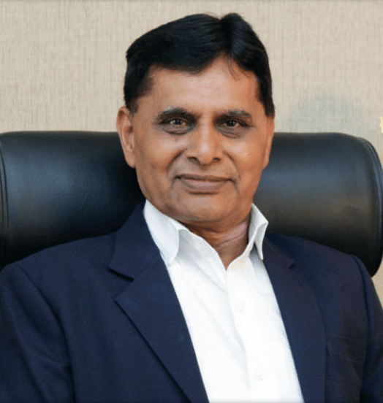
Dr. Ramnik G. Dhamsaniya
President
Dr. Ramnik G. Dhamsaniya, the vibrant and visionary President of Darshan University and prominently recognized as a pivotal pillar and an outstanding administrator in the field of education. Upon completing his Bachelor of Civil Engineering from Lukhdhirji Engineering College, Morbi, Master of Engineering in Structural Engineering & Ph.D. in Concrete Technology from Birla Vishvakarma Mahavidyalaya (BVM), Sardar Patel University.
He has started his career as a lecturer at L. E. College Morbi and worked for 10 years. In 1996, he has moved to V. V. P. engineering college where he has played vital role in the infrastructural & academic development of the institute. He has also worked as a Principal in Atmiya Institute of Technology and Science for Diploma Studies for 2 years.
During 40 years of his career, He has notably contributed to the development of a quality-focused educational system and institutional governance. Being a powerful blend of distinguished academician and profound visionary, he has successfully contributed to bridging the gap between academics and industries. With the notion of skill-based education, he has established Darshan University, which is committed to developing a conducive learning environment, strengthening student progression and promoting value-based education.

Slide 6
Government Scholarships
[1] MYSY (Mukhyamantri Yuva Swalamban Yojana)
Eligibility: Student must have secured 80 or more Percentile in 10th / 12th exam and family income must be less than Rs. 6 lakh/annum.
Amount of Scholarship:
For Degree Engineering: Rs. 50,000/- or 50% of tuition fees whichever is less.
For Diploma Engineering: Rs. 25,000/- or 50% of tuition fees whichever is less.
For B.Com./BBA/BCA/B.Sc.: Up to Rs. 10,000/- or 50% of tuition fees whichever is less.
[2] Scholarships for SC/ST Students
Eligibility: Student must belong to SC or ST category and family income must be less than Rs. 2,50,000/annum.
Amount of Scholarship: Approximately 100% of tuition fees as per Government norms.
[3] Post-Metric Scholarship
Eligibility: Student must belong to SEBC/NT/DNT category and family income must be less than Rs. 2,50,000/annum.
Amount of Scholarship: As per Government norms up to Rs. 5,000 - 15,000/-
[4] Tuition Fee Waiver Scheme (TFWS)
Under the TFW scheme, students do not have to pay the tuition fee (Rs. 60,000 to Rs. 1,00,000 approx.) in SFI Institutes.
5% of total seats shall be filled by TFW scheme, e.g. 60 seats than 3 seats shall be filled by TFWS.
Students whose parent's income is less than Rs. 8 lakh/annum are eligible for TFWS.
Admission is strictly on merit numbers through the admission committee.
TFW scheme shall be applicable for the complete duration of the course (4 Years).
To get the benefits of the TFW Scheme, the candidate has to submit the income certificate issued after 31st March from either 'Mamlatdar' or ''Taluka Development Officer (TDO)' or 'Collector (Jan Seva Kendra)' at the time of application form filling (registration for admission).
No other document shall be considered valid (e.g. Income tax return, Certificate issued by 'Sarpanch', etc.).
Visit darshan university wesite

Slide 8
Thank You

